Slide 1
Introduction To Artificial Intelligence

Slide 2
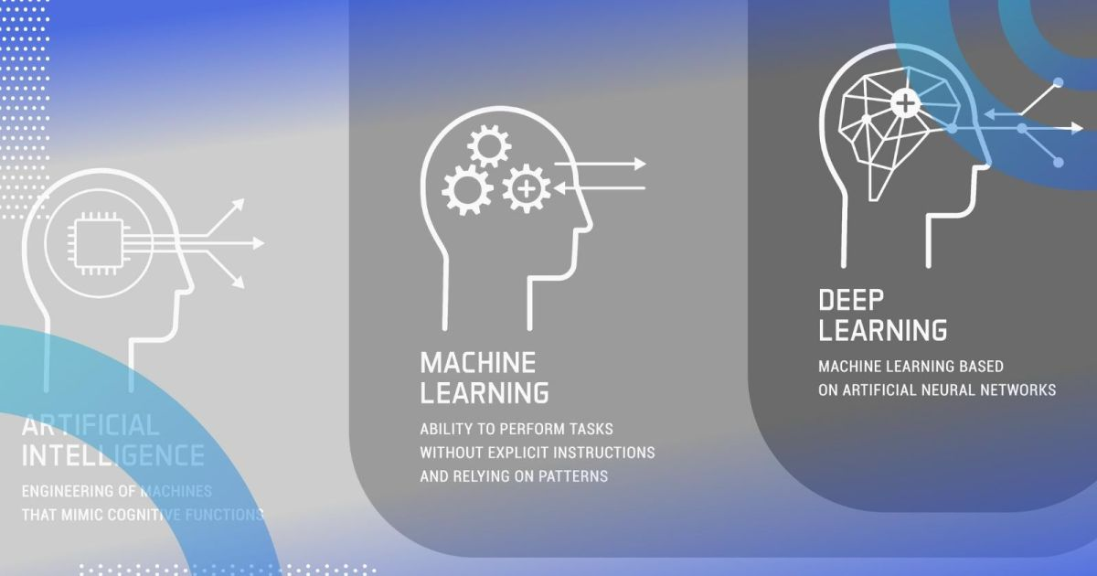
What is AI?
Artificial intelligence, or AI, is technology that enables computers and machines to simulate human intelligence and problem-solving capabilities.
Notes:
AI is a broad area of computer science. On its own or combined with other technologies (e.g., sensors, geolocation, robotics) AI can perform tasks that would otherwise require human intelligence or intervention. Digital assistants, GPS guidance, autonomous vehicles, and generative AI tools (like Open AI's Chat GPT) are just a few examples of AI in the daily news and our daily lives.
As a field of computer science, artificial intelligence encompasses (and is often mentioned together with) machine learning and deep learning. These disciplines involve the development of AI algorithms, modeled after the decision-making processes of the human brain, that can ‘learn’ from available data and make increasingly more accurate classifications or predictions over time.
Artificial intelligence has gone through many cycles of hype, but even to skeptics, the release of ChatGPT seems to mark a turning point. The last time generative AI loomed this large, the breakthroughs were in computer vision, but now the leap forward is in natural language processing (NLP). Today, generative AI can learn and synthesize not just human language but other data types including images, video, software code, and even molecular structures.
Applications for AI are growing every day.

Slide 3
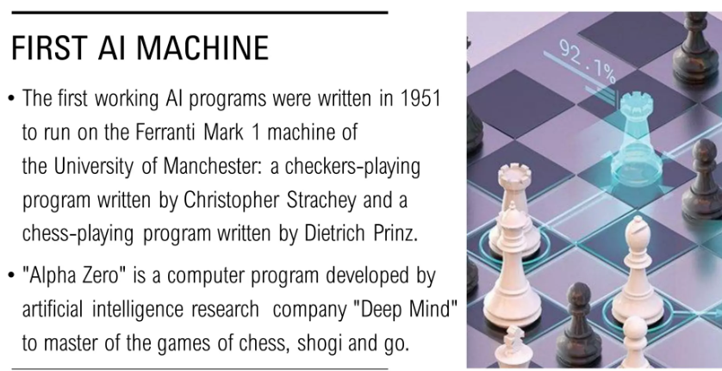

Slide 4
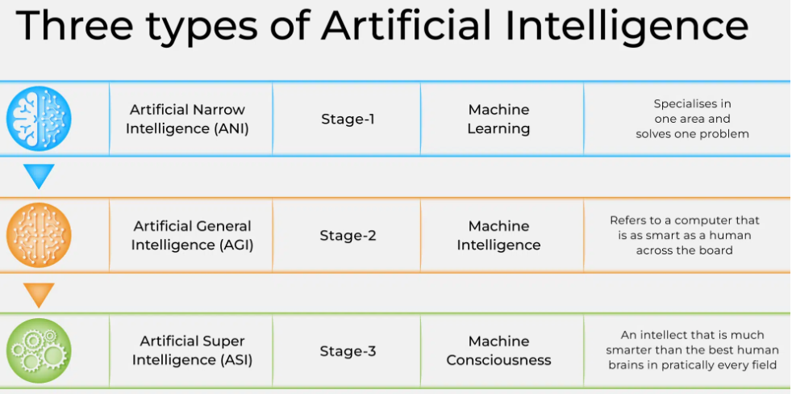
Type of AI?
Notes:
Artificial Narrow Intelligence (ANI) is the current predominant form of AI, adopted in applications on mobile phones, the Internet, and big data analysis. Is designed it for a single task, hence its name, and because of this specificity is also called ‘weak AI‘. This allows it to focus on a task or set of tasks and further optimize its operation.
Narrow AI is what Artificial Intelligence is today, but General AI represents the future of AI. Also known as Artificial General Intelligence (AGI) or Strong Intelligence, General AI could be able to think and function like humans, including perceptual tasks such as vision and language processing, as well as cognitive tasks such as processing, contextual understanding, and general thinking. Narrow AI is created to perform specific tasks, but general AI could be broad and adaptable.
ASI, or Artificial Super Intelligence, would represent the pinnacle of Artificial Intelligence and would surpass human cognition in every way. Although still a theory, experts agree that ASI could result from the explosion of Artificial Intelligence, i.e. an exponential growth of AI algorithms.

Slide 5
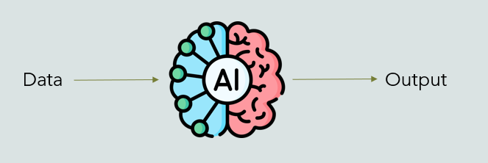
Machine Learning & Deep Learning
Machine learning (ML) is a subdomain of artificial intelligence (AI) that focuses on developing systems that learn—or improve performance—based on the data they ingest.
Deep learning is a branch of machine learning which is completely based on artificial neural networks, as neural networks are going to mimic the human brain so deep learning is also a kind of mimic of the human brain.

Slide 6

Where is AI used ?
Notes:
Tesla has become almost synonymous with the modern electric vehicle. Still, it’s their use of AI that truly sets them apart. How? By integrating advanced AI, Tesla has elevated autonomous driving to new heights. The AI used in Tesla’s fleet isn’t just about navigating from point A to B; it’s about understanding and reacting to dynamic road conditions in real time, making split-second decisions for safety and efficiency. Why is this important? For businesses in the automotive sector, Tesla’s model showcases the potential of AI to not only enhance driver experience but also to push the boundaries of what we consider possible in vehicle autonomy.
BMW’s approach demonstrates the versatility of AI applications in the automotive industry. By embedding approximately 400 AI applications, BMW has streamlined everything from the initial concept of a vehicle to its energy consumption
Waymo stands out for its commitment to AI-driven autonomous driving technologies. Their use of AI extends beyond passenger vehicles to include delivery vans, taxis, and tractor-trailers
Nvidia’s role in the automotive AI revolution is pivotal. They specialize in processing complex sensor data, a fundamental aspect of autonomous vehicle technology. This involves interpreting input from various sensors and cameras, allowing vehicles to ‘understand’ their surroundings

Slide 7
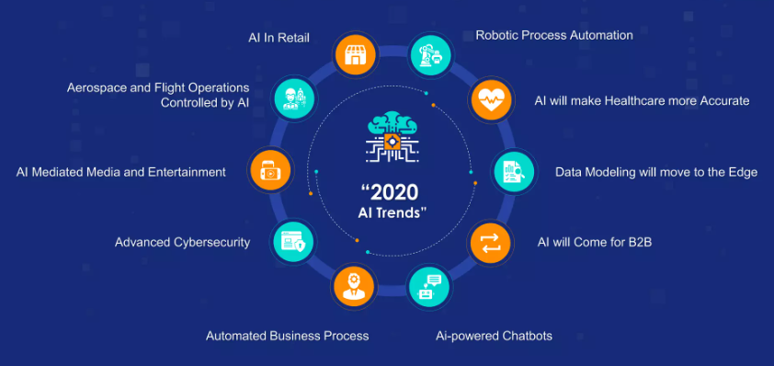
AI Trend

Slide 8
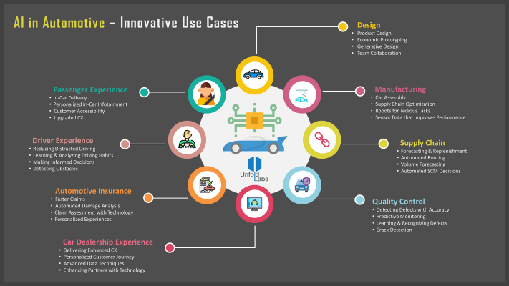
AI in Automotive field

Slide 9
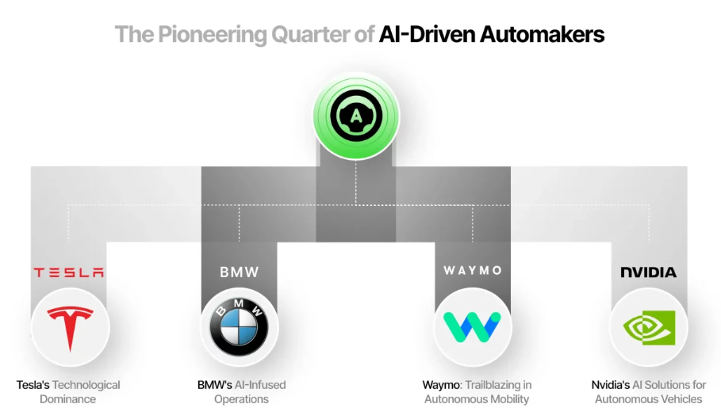
AI in Automotive field - Pioneer
Notes:
Tesla has become almost synonymous with the modern electric vehicle. Still, it’s their use of AI that truly sets them apart.
BMW’s approach demonstrates the versatility of AI applications in the automotive industry. By embedding approximately 400 AI applications, BMW has streamlined everything from the initial concept of a vehicle to its energy consumption.
Waymo stands out for its commitment to AI-driven autonomous driving technologies. Their use of AI extends beyond passenger vehicles to include delivery vans, taxis, and tractor-trailers
Nvidia’s role in the automotive AI revolution is pivotal. They specialize in processing complex sensor data, a fundamental aspect of autonomous vehicle technology. This involves interpreting input from various sensors and cameras, allowing vehicles to ‘understand’ their surroundings

Slide 10
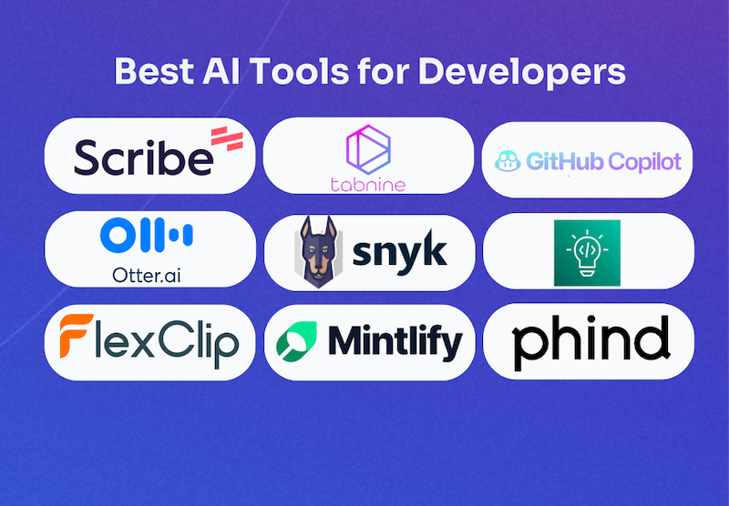
AI for Developer
Suggest codes.
Autocomplete code in any programming language.
Debug or clean your code.
Test it to make sure it works.
Capture and document your processes.

Slide 11
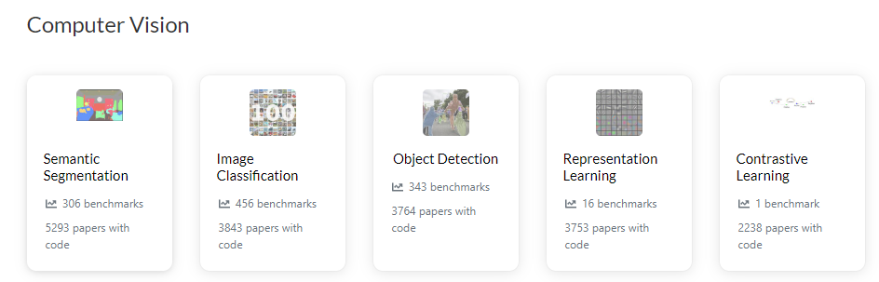
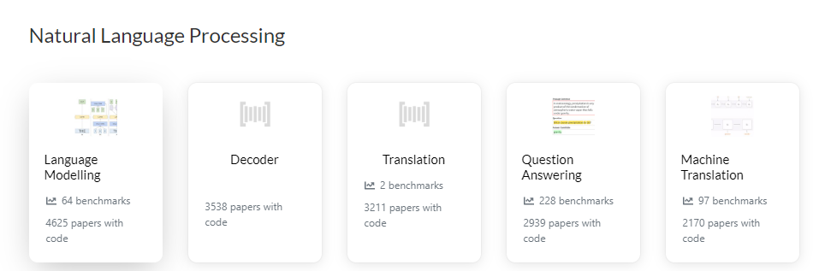
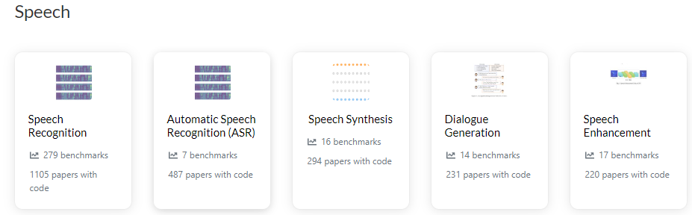
AI Technology

Slide 12
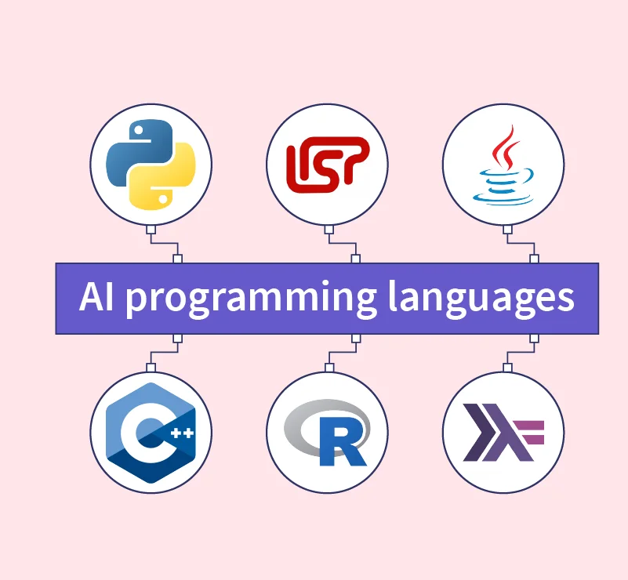
Program language for AI

Slide 13
Beginer Cource
https://www.geeksforgeeks.org/machine-learning/
https://www.geeksforgeeks.org/deep-learning-tutorial/

Slide 14
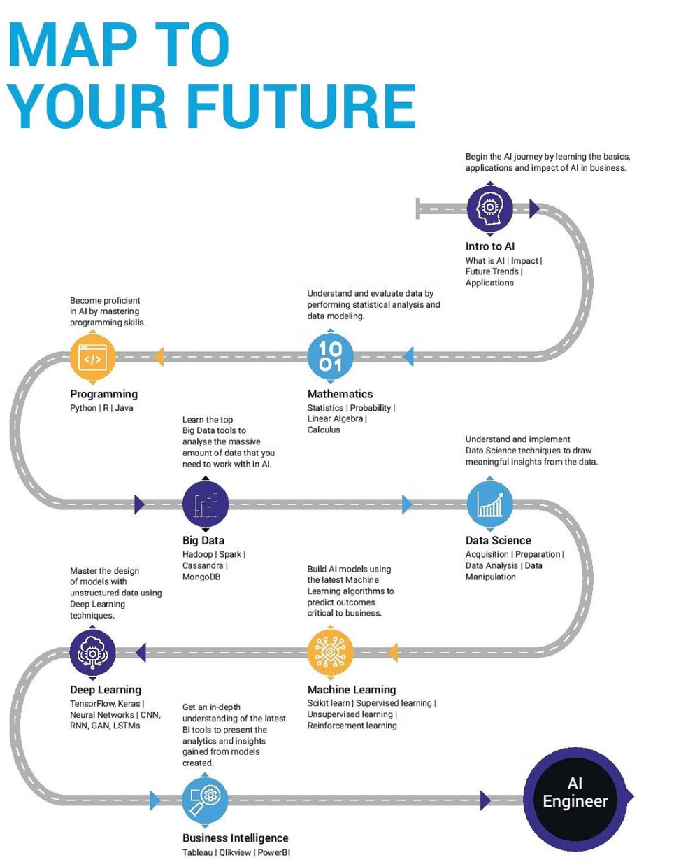
Roadmap

Slide 15
End

